Slide 1



AutoBuddy: A Car Shopping Search Chatbot
Farid Ghorbani
INFO7375 - Prompt Engineering & AI Summer Full 2024

Slide 2
Brief Overview
AutoBuddy is an AI-powered chatbot for personalized car shopping. It uses natural language processing and RAG to provide efficient search experiences based on user preferences, budget, and criteria.
Importance and Relevance:
The project addresses a significant market need for efficient car shopping tools, enhancing the buying experience and leveraging AI for consumer benefit.

Slide 3
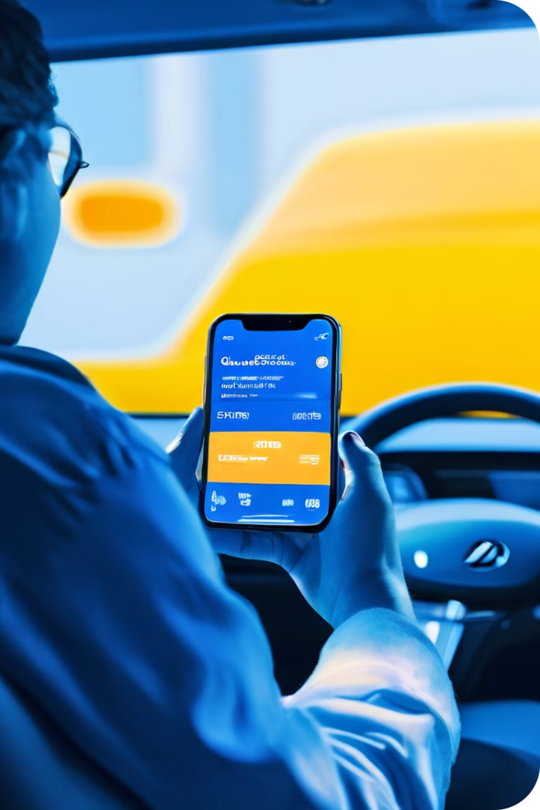
Project Description
1
User Interaction
Chatbot interface for personalized car search queries.
2
Advanced Search
Filtering options to match user preferences.
3
Dealer Integration
Access to car listings and dealer information.
4
Scheduling
Test drive booking and notification features.

Slide 4
Conversation Flow Example:
User: Hi, I'm looking for a new car.
AutoBuddy: Hi there! I'd love to help you find the perfect car. Do you have any specific preferences or requirements? For example, budget, car type, brand, fuel efficiency, or any specific features
User: I'm looking for an SUV under $30,000, preferably a hybrid.
AutoBuddy: Great choice! SUVs are versatile and hybrids are excellent for fuel efficiency. Let me find some options for you. Do you have any preferred brands or additional features in mind?
…

Slide 5
Project Architecture
User Interface
Backend
Data Sources
Chatbot interface built with Streamlit for user interactions.
LangChain and RAG for query processing and data retrieval.
Car listings and dealer info stored in Pinecone.
LLM
OpenAI API for natural language processing and response generation.

Slide 6
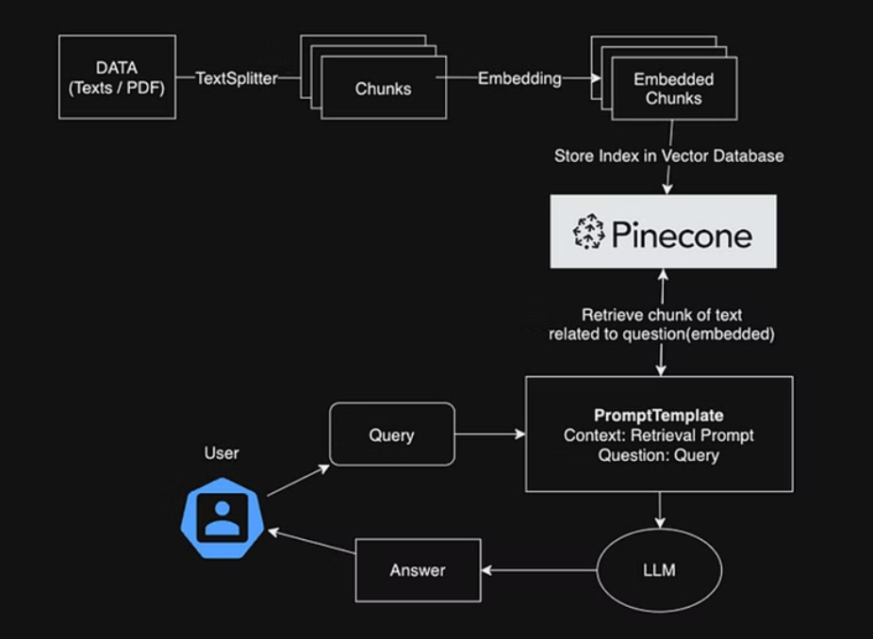
Project Architecture

Slide 7
Data Collection
Sources
Content
Methods
Various online new car company and dealer inventories websites.
Car specifications, prices, features, and dealer information.
Web scraping and API integration with databases.

Slide 8




RAG Pipeline Implementation
Query Understanding
NLP techniques parse user queries.
Document Retrieval
Pinecone retrieves relevant data snippets.
Response Generation
OpenAI API generates responses based on retrieved data.
Integration
LangChain combines outputs for final response.

Slide 9
Performance Metrics
Metric
Description
Calculation Method
Response Accuracy
Relevance of information
Manual evaluation
User Satisfaction
User feedback and ratings
Surveys and forms
Robustness
Handling of ambiguous, tricky inputs
Manual evaluation

Slide 10
Improving Metrics
1
User Feedback
2
Data Enhancement
3
Expected Impact
Incorporate user input for continuous improvements.
Expand and refine data sources and database.
Improved user experience, accuracy, and efficiency.

Slide 11

Deployment Plan
1
Development
Finalize and test the chatbot application.
2
Containerization
Create deployable image using Docker.
3
Hosting
Deploy on AWS for scalability and reliability.
4
User Testing
Conduct beta testing and gather feedback.

Slide 12




Future Work
Expansion
Integrate more car listing platforms and markets.
Partnerships
Develop exclusive deals with car dealerships.
AI Enhancement
Explore advanced AI for personalized experiences.

Slide 13



Ask Questions
Engage in Discussion
Find Solutions
Feel free to ask any questions you may have. We're here to provide helpful answers.
Participate in the conversation and share your thoughts and experiences with the group.
Together, we can explore ideas and find the best solutions to your questions or concerns.

